Slide 1
Multimedia: Making it Work
Chapter 05
Sound

Slide 2
Sound
Introduction to sound.
Multimedia system sound.
Digital audio.
MIDI audio.
Audio file formats.
MIDI versus digital audio.
Adding sound to multimedia project.
Professional sound.
Production tips.

Slide 3
Introduction to sound
Vibrations in the air create waves of pressure that are perceived as sound.
Sound waves vary in sound pressure level (amplitude) and in frequency or pitch.
‘Acoustics’ is the branch of physics that studies sound.
Sound pressure levels (loudness or volume) are measured in decibels (dB).

Slide 4
Multimedia System Sound
System sounds are assigned to various system events such as startup and warnings, among others.
In Windows, available system sounds include start.wav, chimes.wav, and chord.wav.
Multimedia sound is either digitally recorded audio or MIDI (Musical Instrumental Digital Interface) music.

Slide 5
Digital Audio
Digital audio is created when you represent the characteristics of a sound wave using numbers—a process referred to as digitizing.
You can digitize sound from a microphone, a synthesizer, existing recordings, live radio and television broadcasts, and popular CD and DVDs.

Slide 6
Digital Audio
Digital audio data is the actual representation of sound, stored in the form of samples.
Samples represent the amplitude (or loudness) of sound at a discrete point in time.
Quality of digital recording depends on the sampling rate, (or frequency) that is, the number of samples taken per second.

Slide 7
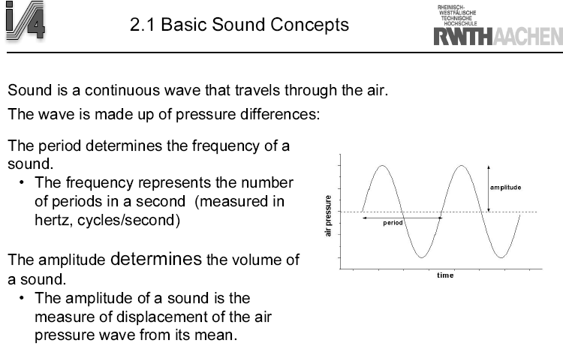
Basic Sound Concepts

Slide 8
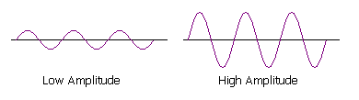
Amplitude and Frequency
There are two main properties of a regular vibration - the amplitude and the frequency - which affect the way it sounds.
Amplitude is the size of the vibration, and this determines how loud the sound is. We have already seen that larger vibrations make a louder sound.
Amplitude is important when balancing and controlling the loudness of sounds, such as with the volume control on your CD player. It is also the origin of the word amplifier a device which increases the amplitude of a waveform.

Slide 9
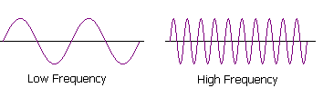
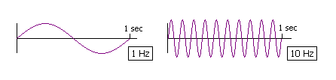
Amplitude and Frequency
Frequency is the speed of the vibration, and this determines the pitch of the sound. It is only useful or meaningful for musical sounds, where there is a strongly regular waveform.
Frequency is measured as the number of wave cycles that occur in one second. The unit of frequency measurement is Hertz (Hz for short).
A frequency of 1 Hz means one wave cycle per second. A frequency of 10 Hz means ten wave cycles per second, where the cycles are much shorter and closer together.

Slide 10
Storing Sound Digitally
Sampling followed by Quantization
  Sampling: periodically measuring the analogue signal
  Quantizing: discrete representation of continuous values

Slide 11
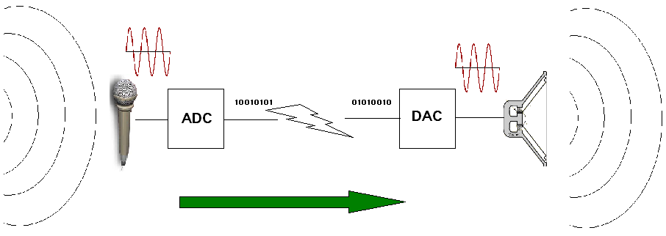
Describing a digital sound
Sampling rate
  Eg. 8KHz; that is 8000 samples per second
Quantizing levels
  8 bits per sample; that is 256 discrete level

Slide 12
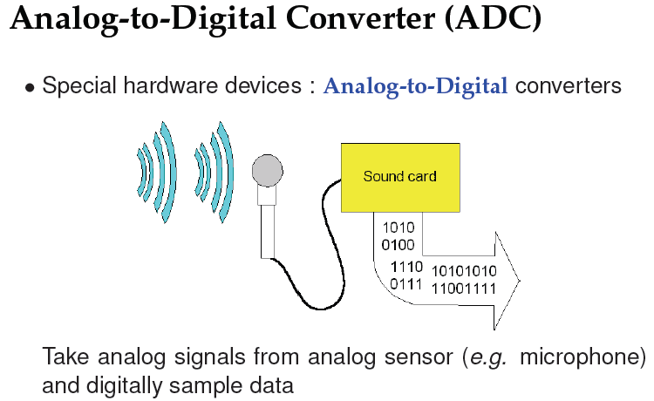
ADC

Slide 13
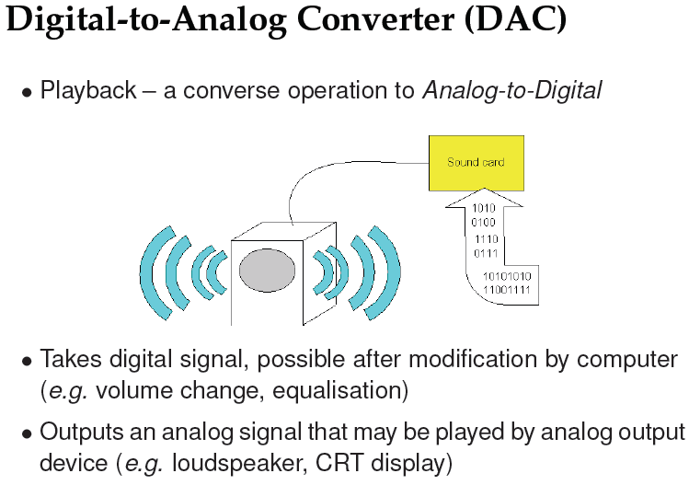
DAC

Slide 14
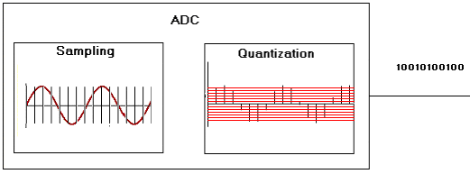
ADC
Analogue to Digital Convertor

Slide 15
Eg. Convert the following analogy Sound signal to digital using
5Hz sampling rate and2 bits
amplitude
1
Time (sec)
2
3
2
1
0
amplitude
1
Time (sec)
2

Slide 16
Eg. Convert the following analogy Sound signal to digital using 5Hz sampling rate and2 bits
amplitude
1
Time (sec)
2
3
2
1
0
amplitude
1
Time (sec)
2

Slide 17
Eg. Convert the following analogy Sound signal to digital using 5Hz sampling rate and2 bits
11
10
01
00
amplitude
1
Time (sec)
2
3
2
1
0
amplitude
1
Time (sec)
2

Slide 18
Eg. Convert the following analogy Sound signal to digital using 5Hz sampling rate and2 bits
11
10
01
00
amplitude
1
Time (sec)
2
3
2
1
0
amplitude
1
Time (sec)
2
The resulting data are stored as follow
01 10 11 10 10 11 10 00 01 10

Slide 19
Eg. Convert the following analogy Sound signal to digital using 5Hz sampling rate and2 bits
11
10
01
00
amplitude
1
Time (sec)
2
Digitized resulted signal
amplitude
1
Time (sec)
2
The resulting data are
01 10 11 10 10 11 10 00 01 10

Slide 20
Example
What is a sound with a voltage equal to 9.5 is represented in a 4 bit A/D converter with a 15v maximum value?

Slide 21
Example
What is a sound with a voltage equal to 9.5 is represented in a 4 bit A/D converter with a 15v maximum value?
First find the voltage step: (4 bit) = 16 level → 15/16 = 0.9 volt

Slide 22
Example
0000 0
0001 .9
0010 1.8
0011 2.7
0100 3.6
0101 4.5
0110 5.4
0111 6.3
Construct the A/D table →
1000 7.2
1001 8.1
1010 9
1011 9.9
1100 10.8
1101 11.7
1110 12.6
1111 13.5

Slide 23
Example
0000 0
0001 .9
0010 1.8
0011 2.7
0100 3.6
0101 4.5
0110 5.4
0111 6.3
Look at the first number under 9.5 from table
9 → 1010
1000 7.2
1001 8.1
1010 9
1011 9.9
1100 10.8
1101 11.7
1110 12.6
1111 13.5

Slide 24
Example
0000 0
0001 .9
0010 1.8
0011 2.7
0100 3.6
0101 4.5
0110 5.4
0111 6.3
What is the quantization
error (quality lost)
1000 7.2
1001 8.1
1010 9
1011 9.9
1100 10.8
1101 11.7
1110 12.6
1111 13.5

Slide 25
Example
0000 0
0001 .9
0010 1.8
0011 2.7
0100 3.6
0101 4.5
0110 5.4
0111 6.3
What is the quantization error (quality lost)
1010 → 9 volt out D/A
Where the input was 9.5 so the difference
9.5 – 9.0 = 0.5 volt
1000 7.2
1001 8.1
1010 9
1011 9.9
1100 10.8
1101 11.7
1110 12.6
1111 13.5

Slide 26
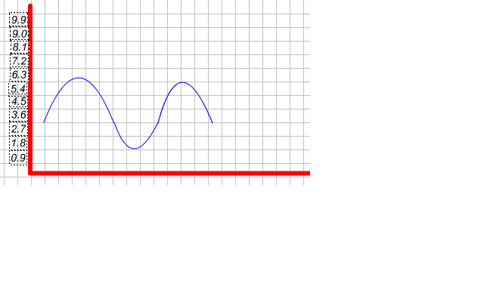
A/D
→
sec | .1 | .2 | .3 | .4 | ---
vol | 3.6 | 5.4 | 6.3 | 6.3 | ---
sec | .1 | .2 | .3 | .4 | ---
Digit | 0100 | 0110 | o111 | 0111 | ---

Slide 27
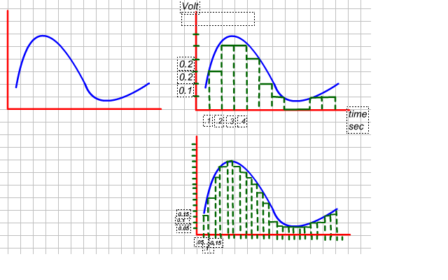
To increase the digitizing quality you must do what
Blue
Analog signal
Green
Digital signal

Slide 28
To digitizing quality you must do what
1- increase the bit depth
e.g. 3 bit to 4 bit
2- increase the sample rate
e.g. .1 sample/sec → .05 sample/sec

Slide 29
Sample Rates and Bit Size
How do we store each sample value (Quantisation)?
8 Bit Value (0-255)
16 Bit Value (Integer) (0-65535)
How many Samples to take?
11.025 KHz — Speech (Telephone 8 KHz)
22.05 KHz — Low Grade Audio
(WWW Audio, AM Radio)
44.1 KHz — CD Quality

Slide 30
Digital Audio
Crucial aspects of preparing digital audio files are:
  Balancing the need for sound quality against available RAM and hard disk resource.
  Setting appropriate recording levels to get a high-quality and clean recording.

Slide 31
Digital Audio
Once a recording had been completed, it almost always needs to be edited.
Basic sound editing operations include trimming, splicing and assembly, volume adjustments and working on multiple tracks.

Slide 32
MIDI Audio
MIDI (Musical Instrument Digital Interface) is a communications standard developed in the early 1980s for electronic musical instruments and computers.
MIDI data is not digitized sound; it is a shorthand representation of music stored in numeric form.
MIDI is device dependent

Slide 33
MIDI Versus Digital Audio
MIDI is device dependent while digitized audio is device independent.
MIDI files are much smaller than digitized audio.
MIDI files sound better than digital audio files when played on a high-quality MIDI device.

Slide 34
MIDI Versus Digital Audio
MIDI files contain no sound. Repeat, MIDI files contain no sound! They contain only performance data.
Piano Rolls
In years gone by, player pianos played music by "reading" holes punched in a roll of paper. You could hold that paper to your ear all day long and never hear any sound from it. That's because the paper was only a conveyor of information. It told the piano what notes to play, but the piano did the actual playing.
MIDI files are the piano rolls of the electronic age. They contain no sound, but tell the computer or electronic keyboard what to play.

Slide 35
MIDI Versus Digital Audio
A MIDI file contains a set of *instructions* for how the music should be played and what instrument should play the sound.
The MIDI file does not contain the actual sounds, it only contains instructions for what sound should be played, how it should be played and when it should be played.
When you want to hear the contents of the MIDI commands (the "MIDI sequence") the MIDI file
must send its commands to some kind of electronic sound generator, which then makes the sounds following the MIDI sequence's commands

Slide 36
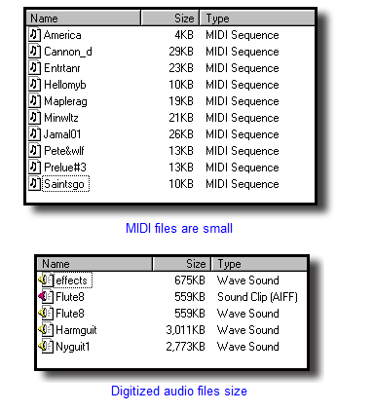
MIDI Versus Digital Audio
MIDI files are much more compact than digital audio files, and the size of MIDI file is completely independent of playback quality. In general, MIDI files will be 200 to 1000 times smaller than CD-quality digital audio files. Because MIDI files are small, they don’t take up as much RAM, disk space, and CPU resources.

Slide 37
Audio File Formats
A sound file’s format is a recognized methodology for organizing data bits of digitized sound into a data file.
In Windows, digitized sounds are usually stored as WAV files.

Slide 38
Adding Sound to Multimedia Project
File formats compatible with multimedia authoring software being used along with delivery mediums, must be determined.
Sound playback capabilities offered by end user’s system must be studied.

Slide 39
Adding Sound to Multimedia Project
The type of sound, whether background music, special sound effects, or spoken dialog, must be decided.
Digital audio or MIDI data should be selected on the basis of the location and time of use.

Slide 40
Adding Sound to Multimedia Project
Whether you’re working on a Macintosh or in Windows, you will need to follow certain steps to bring an audio recording into your multimedia project. Here is a brief overview of the process:
  Determine the file formats that are compatible with your multimedia authoring software and the delivery medium(s) you will be using (for file storage and bandwidth capacity).
  Determine the sound playback capabilities that the end user’s system offers.
  Decide what kind of sound is needed (such as background music, special sound effects, and spoken dialog). Decide where these audio events will occur in the flow of your project.
  Decide where and when you want to use either digital audio or MIDI data.
  Acquire source material by creating it from scratch or purchasing it.
  Edit the sounds to fit your project.
  Test the sounds to be sure they are timed properly with the project’s images.

Slide 41
Summary
Vibrations in air create waves of pressure that are perceived as sound.
Multimedia system sound is digitally recorded audio or MIDI (Musical Instrumental Digital Interface) music.
Digital audio data is the actual representation of a sound, stored in the form of samples.

Slide 42
Summary
MIDI is a shorthand representation of music stored in numeric form.
Digital audio provides consistent playback quality.
MIDI files are much smaller than digitized audio.
MIDI files sound better than digital audio files when played on high-quality MIDI device.

